Slide 1
Introduction to Computer Architecture
LO:
Computer Architecture

Slide 2
Introduction to Computer Architecture
LO:
Specification Point
3.7.1.1 Internal hardware components of a computer

Slide 3
Introduction to Computer Architecture
LO:
Overview
A computer is any machine or device that processes data.
The word computer also implies that the machine is electronic or digital.
In simple terms this means that it will contain one or more microprocessors that can be programmed to control the device.
Microprocessors are made up of microscopic electronic circuits and belong to a group of devices commonly referred to as chips.

Slide 4
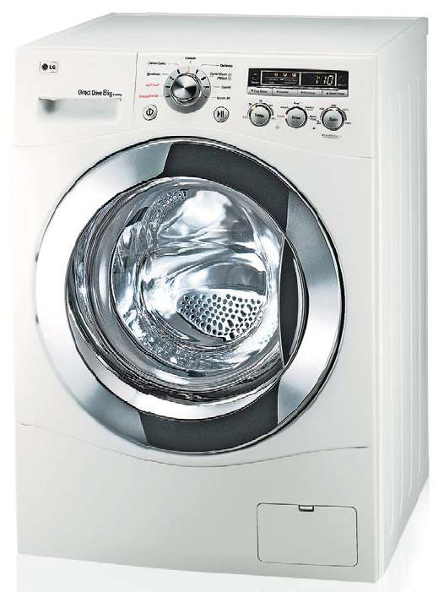
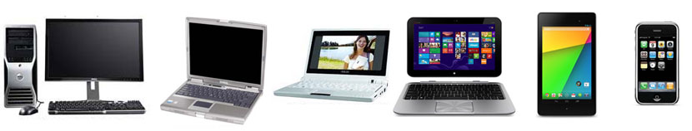
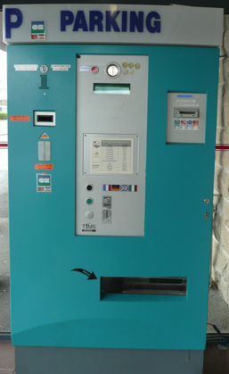
Introduction to Computer Architecture
LO:
Overview

Slide 5
Introduction to Computer Architecture
LO:
Three Box Model
xx
Input
Process
Output
Keyboard
Mouse
Microphone
Process instructions
VDU
Printer
Speakers

Slide 6
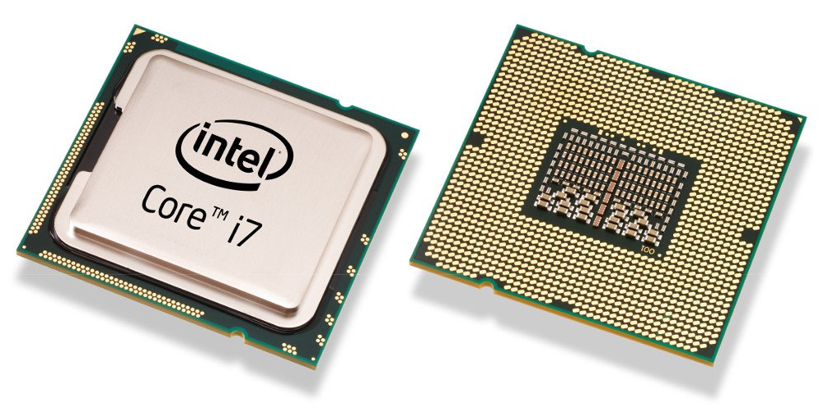
Introduction to Computer Architecture
LO:
The Processor
The processor is a device that carries out computation on data by following instructions. Processors have Instruction Sets
It handles all of the instructions that it receives from the user and from the hardware and software.
Physically, the processor is made up of a thin slice of silicon approximately 2 cm square.
Using microscopic manufacturing techniques, the silicon is implanted with millions of transistors.

Slide 7
Introduction to Computer Architecture
LO:
The Processor
Microscopic wires called buses connect groups of transistors together.
The transistors are used to control the flow of electrical pulses that are timed via the computer’s clock.
The pulses of electricity represent different parts of the instruction that the processor is carrying out.

Slide 8
Introduction to Computer Architecture
LO:
Summary
xx
When a program is running it saves data here temporarily. This is volatile, because when the computer is shut down the data is lost .
Bus
Executes instructions stored in memory and processes data.
Processor
(CPU)
Main Memory
I/O
Unit
This is used to allow the processor to communicate with peripherals such as printers, VDUs, keyboard.

Slide 9
Introduction to Computer Architecture
LO:
Main Memory
RAM is volatile, which means that when you turn your computer off, all of the contents of RAM are lost.
Read Only memory (ROM) is also a method for storing data and instructions that can be accessed by the computer.
However, it is not volatile, which means that the contents of ROM are not lost when you switch off.

Slide 10
Introduction to Computer Architecture
LO:
Buses
Buses are microscopic wires that connect the processor to the various input and output controllers being used by the computer.
They are also used to connect the internal components of a microprocessor, including the registers.
They also connect the microprocessor to memory.
There are three types of bus: data, address and control.

Slide 11
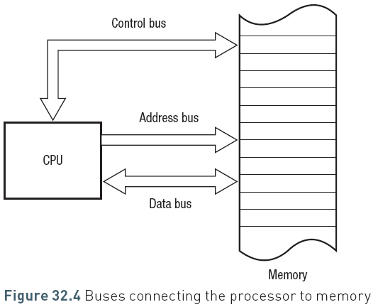
Introduction to Computer Architecture
LO:
Buses and Main Memory
xx

Slide 12
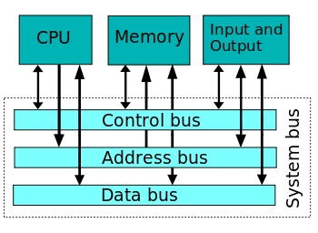
Introduction to Computer Architecture
LO:
Buses and the Three Box Model

Slide 13
Introduction to Computer Architecture
LO:
Data Bus
The instructions and data that comprise a computer program pass back and forth between the processor and memory as the program is run.
The data bus carries the data both to and from memory and to and from the I/O controllers, that is, they are bi-directional or two-way.
The instructions and data held in memory will vary in size.
Each memory cell will have a width measured in bits.
For example, it may have a width of 32 bits.

Slide 14
Introduction to Computer Architecture
LO:
Address Bus
The address bus only goes in one direction – from the processor into memory.
All the instructions and data that a processor needs to carry out a task are stored in memory. Every memory location has an address.
The processor carries out the instructions one after the other.
The address bus is used by the processor and carries the memory address of the next instruction or data item.
The address bus therefore is used to access anything that is stored in memory, not just instructions.

Slide 15
Introduction to Computer Architecture
LO:
Control Bus
The control bus is a bi-directional bus that sends control signals to the registers, the data and address buses.
There is a lot of data flowing around the processor, between the processor and memory, and between the processor and the input and output controllers.
Data buses are sending data to and from memory while address buses send only to memory.
The job of the control bus therefore is to ensure that the correct data is travelling to the right place at the right time.
This involves the synchronisation of signals and the control of access to the data and address buses which are being shared by a number of devices.

Slide 16
Introduction to Computer Architecture
LO:
Control Bus Signals
Clock Signal: timing
Reset Signal: to initialise components
Memory Read: states that the memory location in use is being Read from
Memory Write: states that the memory location in use is being Written to
I/O: indicates where the CPU wishes to use an I/O Controller

Slide 17
Introduction to Computer Architecture
LO:
Example
CPU sends memory address to be accessed over the address bus
CPU asserts over control bus whether it wishes to read from or write to this location
CPU fetches content of memory addresses over the data bus
(the data stored at that location)
Control Bus
Central Processing Unit
Processor
Data & Address Bus
Main Memory
Keyboard
VDU Output Controller
Visual Display Unit
Keyboard Input Controller
(Disk) I/O Controller
Secondary Store
e.g. Hard Drive

Slide 18
Introduction to Computer Architecture
LO:
Input/Output (I/O) Controllers
In addition to the direct link between the processor and main memory, the processor will also receive and send instructions and data to the various input and output devices connected to the computer.
Basic I/O devices would be the keyboard, monitor, mouse and printer though modern computer systems would typically include several other devices.

Slide 19
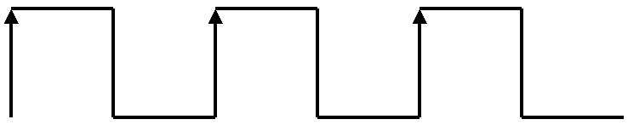
Introduction to Computer Architecture
LO:
The System Clock
A signal used to synchronise components and signals inside the processor
Measured in Hertz (Hz), which is the number of clock cycles per second.
1 Hz = 1 clock cycle per second
1 KHz = 1,000 clock cycles per second
1 MHz = 1,000,000 clock cycles per second
1 GHz = 1,000,000,000 clock cycles per second
1
0
Additional reading:
http://www.pcguide.com/ref/cpu/arch/extClocks-c.html

Slide 20
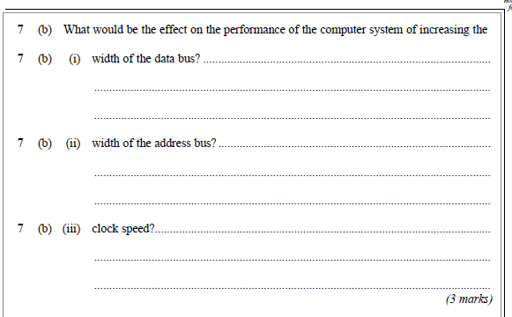
Introduction to Computer Architecture
LO:
Exam Question

Slide 21
Introduction to Computer Architecture
LO:
Prep
xx

Slide 22












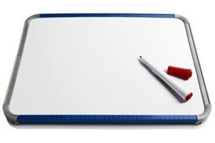


Key words:
Noted clearly
Topic specific vocabulary wherever necessary
Icon for extension activity if appropriate
Icon same colour as dept ex book
You might want to develop subject specific icons

